Slide 1
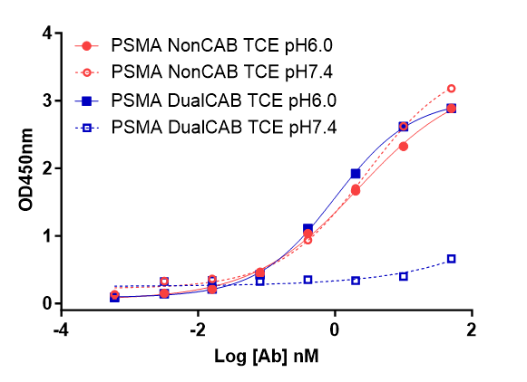
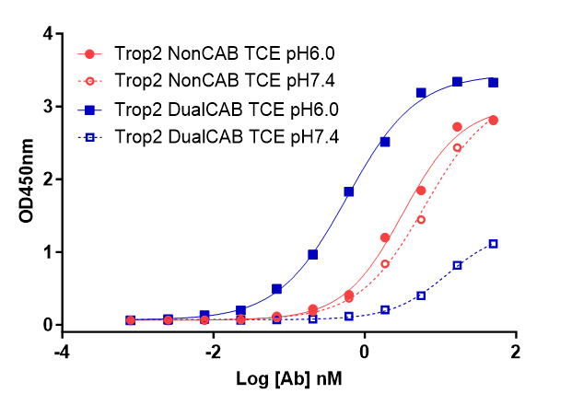
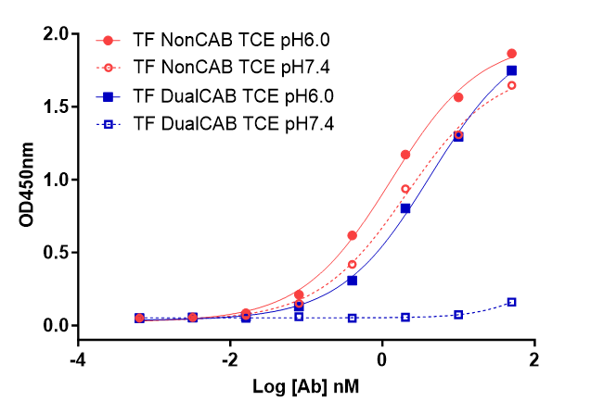
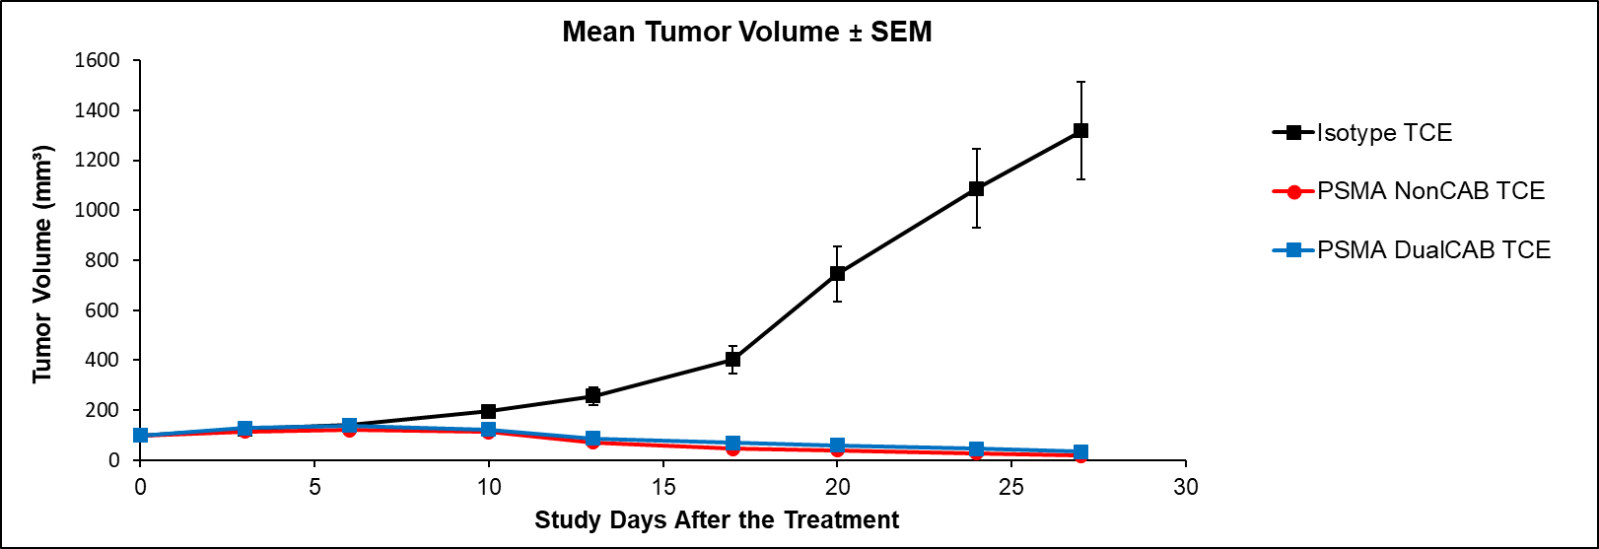
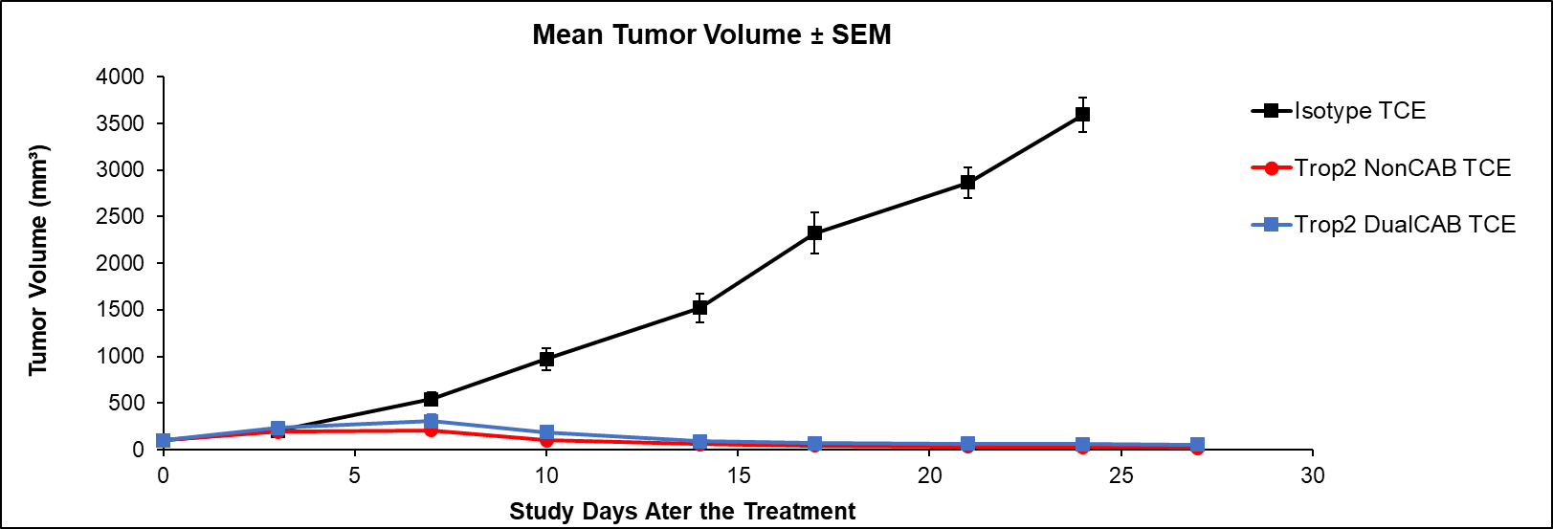
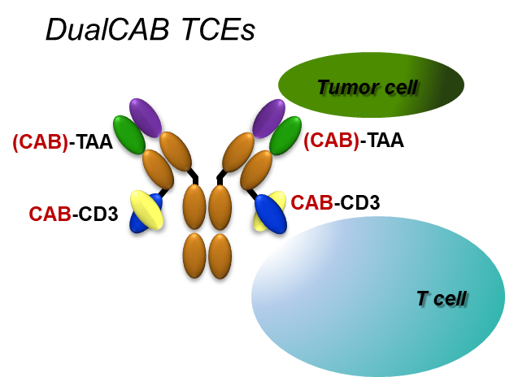
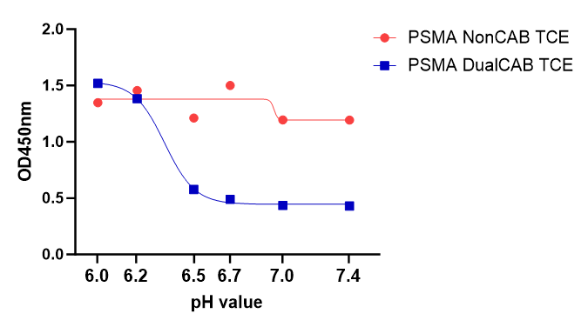
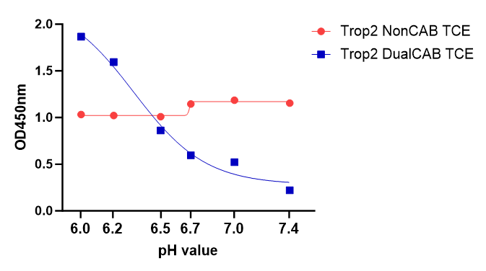
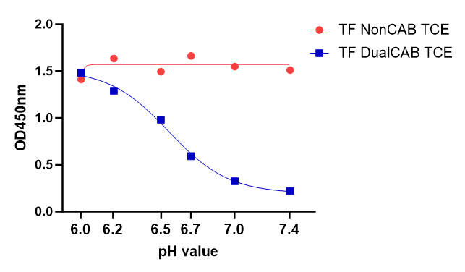
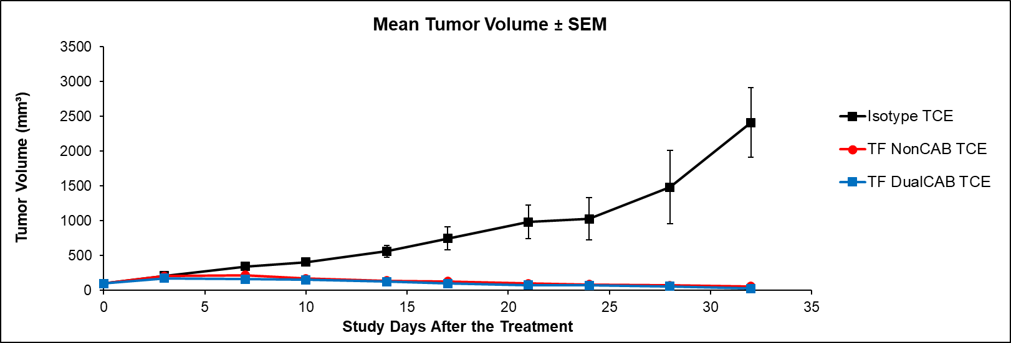
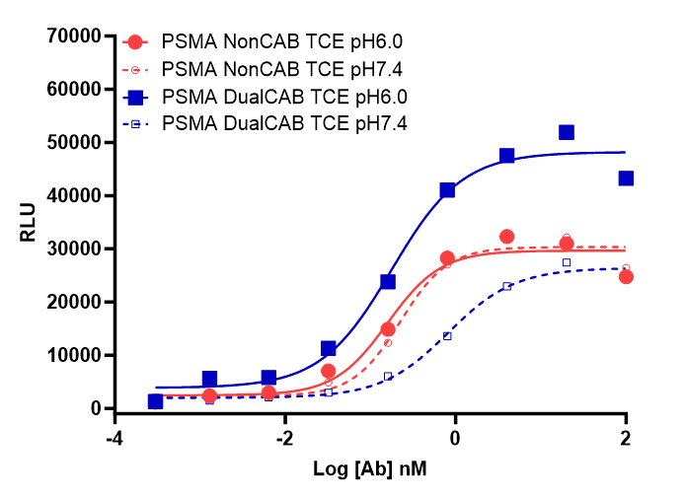
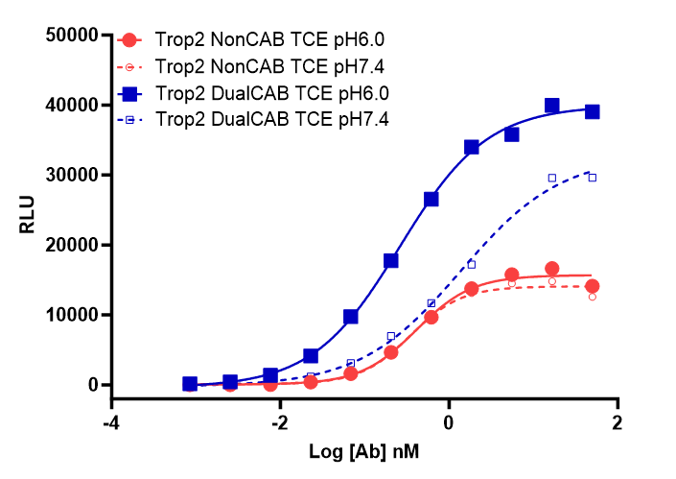
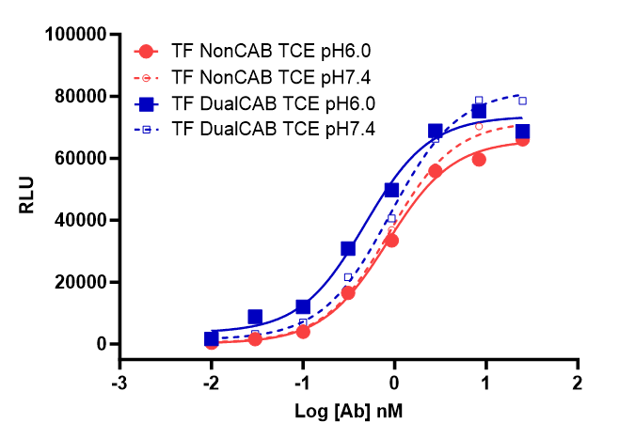
Novel Conditionally Active Biologic Tetravalent T-Cell Engagers Targeting Solid Tumors Haizhen Liu, Ana Paula Cugnetti, Patricia McNeeley, Charles Xing, Kathryn Woodard, Cathy Chang, Gerhard Frey, William J. Boyle and Jay M. Short.
BioAtla, 11085 Torreyana Road, San Diego, CA 92121
Abstract Number 744
INTRODUCTION
RESULTS
RESULTS
The use of T-cell engagers (TCEs) has great therapeutic potential in oncology. This potential, however, is diminished due to severe toxicity (cytokine release effects, as well as on-target off-tumor toxicities). We leveraged BioAtla’s Conditionally Active Biologics (CAB) technology (1) to develop bispecific antibodies which have no or very little binding to CD3 and to the tumor target antigen (TAA) in healthy tissue (normal physiological conditions) but have strong binding in diseased tissues (tumor microenvironment, TME). The conditional activity in the TME is achieved by optimizing the CDR sequences of the binding domains to reduce binding at physiological pH. It does not require masking and subsequent enzymatic activation as it is done in pro-drugs. We have developed DualCAB T-cell engagers targeting several well-established tumor associated antigens. In vitro and in vivo characterization data for three new TCEs, targeting PSMA, Trop2, and Tissue Factor (TF) are presented. The new DualCAB TCE molecules are very potent and show similar efficacy in cell line-derived mouse models as the NonCAB parent molecule.
Figure 2: Differential affinity binding of NonCAB TCE or DualCAB TCE and pH Range ELISA
pH Affinity ELISA applied human CD3 as capture antigen, human TAA-mFc as detection followed by anti-mouse IgG HRP conjugated antibody. DualCAB TCEs showed higher affinity in tumor microenvironment pH (6.0), but lower binding under the physiological pH (7.4). A: PSMA; B: Trop2; C: TF NonCAB TCEs was shown as solid red circle at pH6.0 and open red circle at pH7.4; DualCAB TCE was shown as solid blue square at pH6.0 and open blue square at pH7.4.
Figure 4. DualCAB TCE In vivo efficacy in cell line-derived mouse models.
Tumor-bearing animals were randomized to treatment groups when the tumor volume reached approximately 100-150mm³. Following randomization, animals were dosed with Isotype, NonCAB or DualCAB TCE bispecific antibodies at different doses biweekly for four weeks. DualCAB TCEs demonstrated a comparable tumor regression as NonCAB TCEs.
Prostate cancer cell line LNCaP model was treated with anti-PSMA TCEs (J) at 1 mg/kg dose biweekly for 3.5 weeks.
Human epidermoid carcinoma cell line A431 model was treated with anti-Trop2 (K) or anti-TF (L) TCEs at 2 mg/kg dose biweekly for 4 weeks.
Isotype TCE is shown as solid black squares, NonCAB TCE is shown as solid red circles and DualCAB TCE is shown as solid blue squares.
A
B
C
J
RATIONALE
DualCAB TCEs demonstrated a differential binding with human CD3 as capture antigen, human TAA-mFc as detection following with anti-mouse IgG HRP conjugated antibody with the pH range 6.0-7.4. The affinity binding of NonCAB TCEs remained at a similar level. D: PSMA; E: Trop2; F: TF NonCAB TCE was shown as solid red circle and DualCAB TCE was shown as solid blue square.
Using BioAtla’s Conditionally Active Biologic (CAB) technology (1) we constructed TCEs targeting EpCAM: Non-CAB, MonoCAB (CAB on CD3 binding domain), and DualCAB (CAB on EpCAM and CD3 binding domains) (2). The DualCAB molecule showed highly improved tolerability (20-fold over MonoCAB and >100-fold over Non-CAB) in non-human primates while maintaining potency and efficacy in mouse models. Phase I clinical trials with the DualCAB have been initiated.
Figure 1:
Structure of BioAtla’s Tetravalent DualCAB TCEs (CAB-TAA x CAB-CD3)
D
K
E
F
Figure 3: DualCAB TCE Induces T-cell activation in vitro
LNCaP (PSMA), A431 (Trop2 and TF) cells were co-cultured with TCR/CD3 Jurkat effector cells that express a luciferase reporter driven by NFAT-response element (Promega T-cell Activation Assay) in the presence of TCE bispecific antibodies at pH6.0 and pH7.4 conditions. DualCAB TCE demonstrated a higher potency in inducing cytotoxicity of cancer cells at pH 6.0 (Tumor Microenvironment) and less potent in physiological pH 7.4 (Normal Physiological pH). G: PSMA; H: Trop2; I: TF. NonCAB TCEs was shown as solid red circle at pH6.0 and open red circle at pH7.4; DualCAB TCE was shown as solid blue square at pH6.0 and open blue square at pH7.4.
L
Any IgG1 can easily be converted into a MonoCAB using the same backbone (non-glycosylated IgG1 with anti-CD3-scFv fused to the C-terminus of the light chain, Fig. 1).
DualCABs are then derived from the MonCABs after sequence optimization of the TAA binding domains. We have further developed three new DualCAB TCEs with the same technology for PSMA, Trop2 and Tissue Factor (TF) targeting solid tumors.
1. Chang HW, Frey G, Liu H, Xing C, Steinman L, Boyle WJ, Short JM. Proc Natl Acad Sci U S A. 2021 Mar 2;118(9).3
2. Frey G, Cugnetti AP, Liu H, Xing C, Wheeler C, Chang HW, Boyle WJ, Short JM. MABS. 2024 Vol 16 (1).
G
H
I
CONCLUSIONS
DualCAB TCE bispecific antibody have strong binding to CD3 under tumor conditions compared to low binding under normal physiological conditions.
DualCAB TCE bispecific antibody is more potent in controlling tumor growth in vivo compared the Non-CAB TCE bispecific antibody.
The BioAtla CAB platform offers the potential to broadly transform bispecific solid tumor therapies through the widening of the therapeutic index.
AACR Annual Meeting 2024, April 5-10
DO NOT POST
www.bioatla.com
©2024 BioAtla Incorporation

