Slide 1
Results from a phase 2 part 1 trial of mecbotamab vedotin (BA3011), a CAB-AXL-ADC, in patients with advanced refractory sarcoma
Seth M. Pollack, Anthony P. Conley, William Tap, Chueh-Chuan Yen, John Charlson, Lara E. Davis, Anna Chalmers, Mihaela Druta, Elizabeth T. Loggers, Jaspreet Grewal, Gerald Falchook, Brian Schulte, Thomas Yau, AeRang Kim, Herbert H. Loong, Suzanne George, Bhuvana Setty, Leo Mascarenhas, Gregory M. Cote, Breelyn Wilky
Presented by Seth M. Pollack

Slide 2
DECLARATION OF INTERESTS
Seth M. Pollack
Advisory and consulting fees from Adaptimmune, Bayer, Boehringer Ingelheim, Deciphera, Rain Therapeutics, and SpringWorks

Slide 3
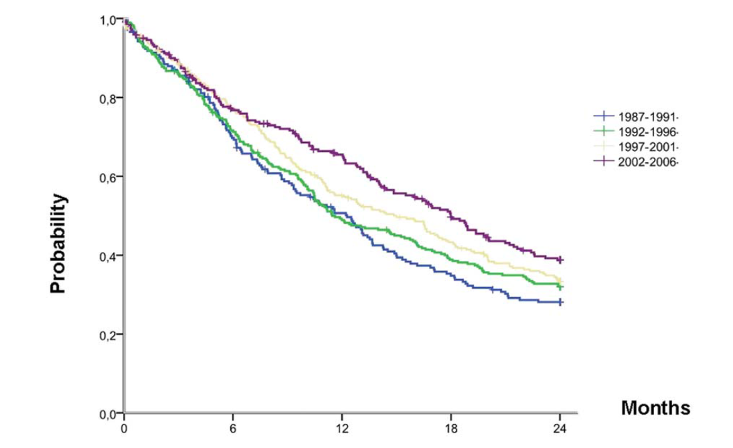
SARCOMAs REMAIN difficult to treat
Limited improvements in overall survival over time for metastatic soft tissue sarcomas¹
Few agents have efficacy in the treatment of osteosarcoma²
Selected Phase II Trials in Osteosarcoma²
Study | No. of Patients | Agent | Response | Years Study Open
A09713 | 10 | Topotecan | No responses | 1995–1998
ADVL0122 | 12 | Imatinib | No responses | 2002–2004
ADVL0421 | 13 | Oxaliplatin | No responses | 2004–2006
ADVL0524 | 11 | Ixabepilone | No responses | 2006–2007
CCG-0962 | 23 | Docetaxel | 1 PR, 1 CR, 2 NE, 19 with no response | 1997–2001
EORTC phase II | 15 | Iproplatin | 1 SD, 14 with no response | 1997–1998
P9761 | 10 | Irinotecan | 9 with no response, 1 NE | 1999–2005
P9963 | 16 | Rebeccamycin | No responses | 2000–2003
Phase II ridaforolimus | NR | Ridaforolimus | 2 PR (total no. of patients NR) | 2004–2005
Patients at risk | 0 | 6 months | 12 months | 18 months | 24 months
1987–1991 | 203 | 141 | 99 | 68 | 54
1992–1996 | 285 | 203 | 137 | 108 | 89
1997–2001 | 280 | 213 | 150 | 115 | 87
2002–2006 | 238 | 179 | 147 | 106 | 80
The historical use of radiographic response as the primary endpoint in osteosarcoma phase II trials has made it difficult to achieve PR²
1. Italiano A, Mathoulin-Pelissier S, Cesne AL, et al. Cancer. 2011;117(5):1049-1054. 2. Isakoff MS, Bielack SS, Meltzer P, Gorlick R. J Clin Oncol. 2015;33(27):3029-3035.
Abbreviations: ADVL, Children's Oncology Group Developmental Therapeutic committee; CCG, Children's Cancer Group; CR, complete response; EORTC, European Organisation for the Research and Treatment of Cancer; NE, not evaluable; NR, not reported; PR, partial response; SD, stable disease.

Slide 4
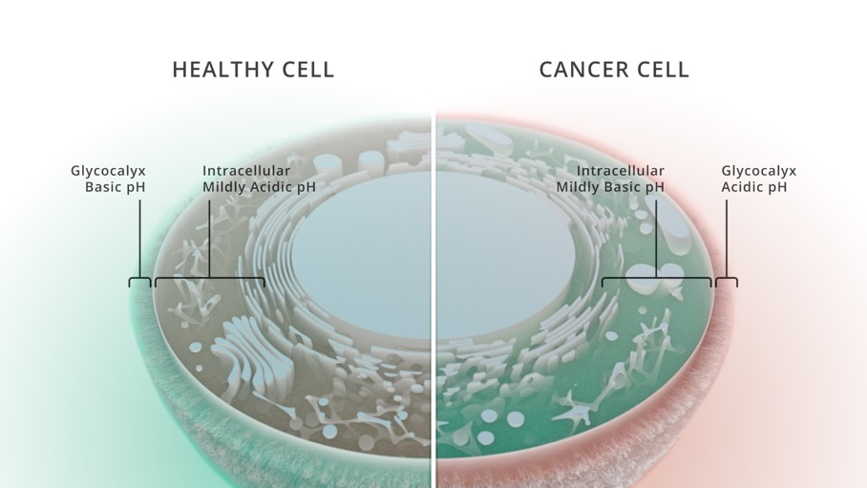






Conditionally active biologic (cAB) technology
Selective and targeted to widen the therapeutic index
Alkaline Healthy Cell Membrane
Acidic Cancer Cell Membrane
Acidic pH (5.8–6.7) at the cancer cell surface unveils binding sites that are shielded at normal pH (6.8 to >7.4)
CAB antibodies (BioAtla Inc.) bind only to these unveiled sites on cancer cells in the tumor microenvironment¹
Not masked or caged, thus differentiating CABs from prodrugs that require irreversible enzymatic cleavage
CABs have the potential for increased efficacy with improved safety relative to traditional antibodies
^{pH 6.8 to >7.4}
^{pH 5.8–6.7}
No CAB binding
CAB binding
H⁺
H⁺
H⁺
H⁺
H⁺
H⁺
H⁺
H⁺
H⁺
H⁺
1. Chang HW, Frey G, Liu H, Xing C, Steinman L, Boyle WJ, Short JM. Proc Natl Acad Sci USA. 2021;118(9):e2020606118.

Slide 5
Mecbotamab Vedotin (BA3011): a cab-axl-adc
AXL is expressed in a variety of tumor types, with overexpression associated with metastasis, tumor resistance to chemotherapy, and poor prognosis^{1,2}
CAB-AXL-ADC pH binding inflection point adjusted for tumor microenvironment selectivity
CAB-tumor cell target
100
Non-CAB AM
Cytotoxic payload and linker
75
    Humanized anti-AXL IgG1
    ~100 pM affinity (pH 6.5)
    VC-MMAE linker and payload
    DAR 4
    Epitope in Ig loop region
Normalized ELISA Data
(OD 450 nm)
Non-CAB
50
Blood
BA3011
25
CAB AM
0
6.00
6.25
6.50
6.75
7.00
7.25
7.50
pH value
≥7.4 is pH of normal cell
1. Gay CM, Balaji K, Byers LA. Br J Cancer. 2017;116(4):415-423. 2. Zhang G, Wang M, Zhao H, Cui W. Oncol Lett. 2018;15(3):2726-2734.
Abbreviations: ADC, antibody-drug conjugate; AM, affinity matched; CAB, conditionally active biologic; DAR, drug antibody ratio; ELISA, enzyme linked immunosorbent assay; Ig, immunoglobulin; OD, optical density; VC-MMAE, valine-citrulline monomethylauristatin E.

Slide 6
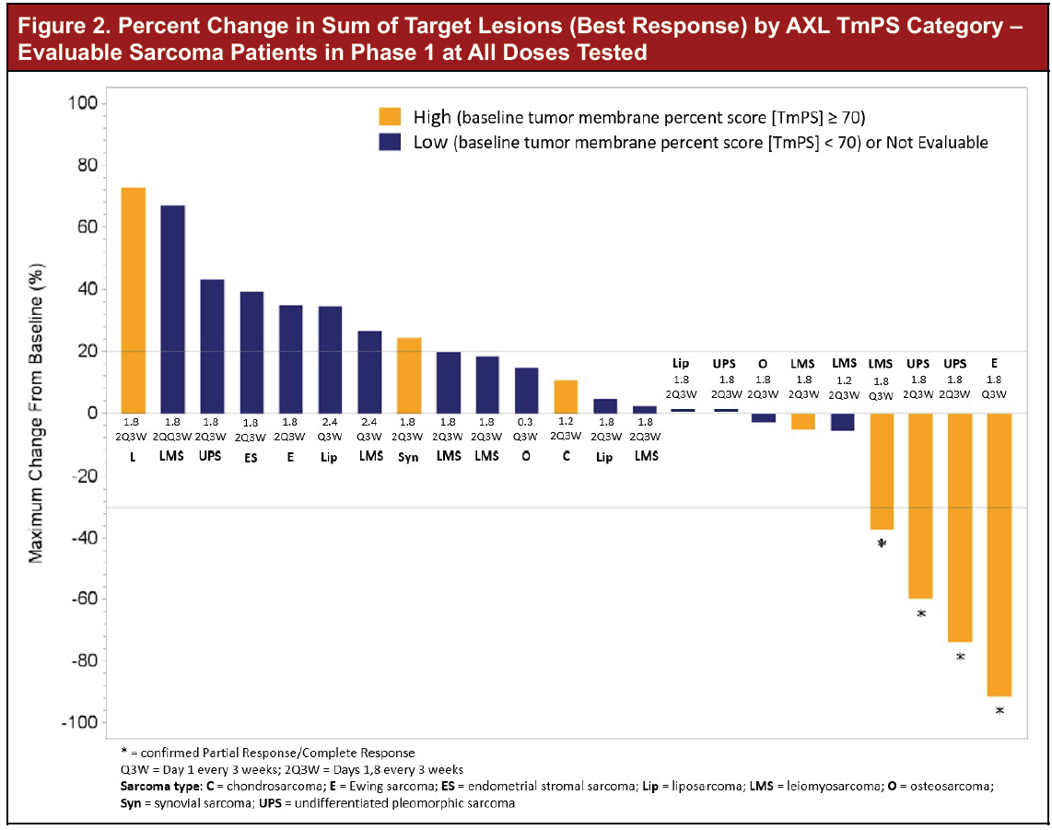
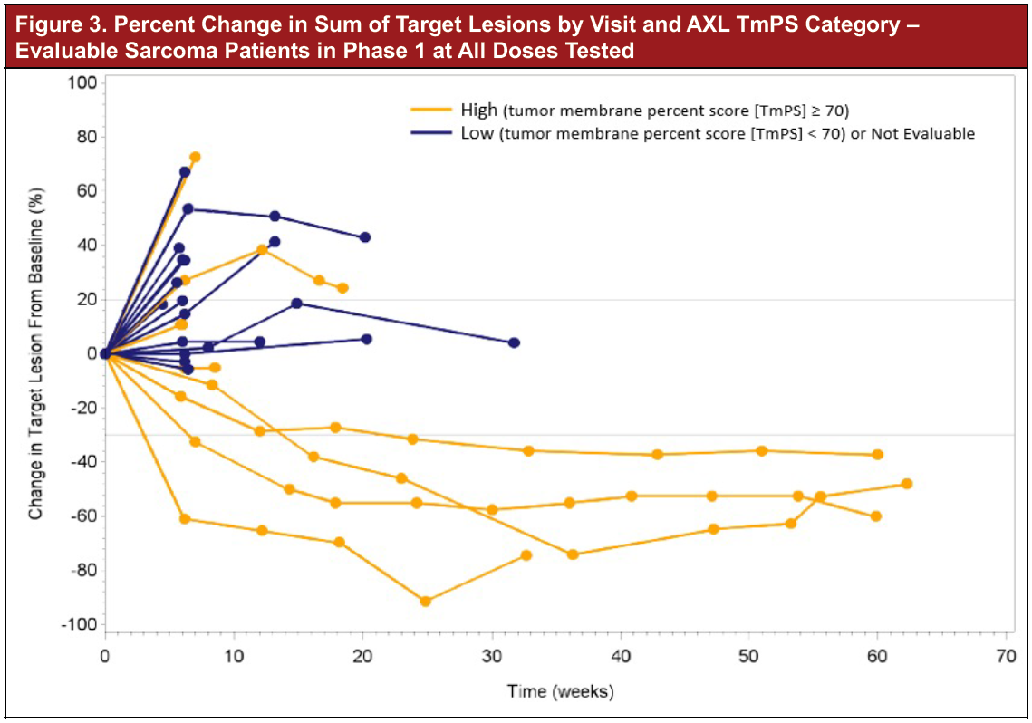
CAB-axl-adc: Phase 1 results
Durable responses observed among patients with UPS, LMS, and Ewing sarcoma; prospective, phase 2, single-arm UPS trial presently enrolling with data to be reported separately
1. Wilky B, Druta M, Ahnert JR, et al. Poster presented at: Connective Tissue Oncology Society Annual Meeting; November 10-13, 2021.
Abbreviations: ADC, antibody-drug conjugate; AM, affinity matched; CAB, conditionally active biologic; LMS, leiomyosarcoma; UPS, undifferentiated pleomorphic sarcoma.

Slide 7
Phase 2 part 1 open-label Study design
Inclusion criteria
≥12 years of age
AXL-expressing† locally advanced, unresectable, or metastatic sarcoma
Measurable disease by RECIST v1.1
Received ≥1 regimen containing anthracycline and ≤3 prior lines of approved systemic therapy for histologic subtypes that typically receive chemotherapy‡
BA3011 1.8 mg/kg monotherapy Q2W
Endpoints
DCR (objective response or stable disease for ≥12 weeks)
Number of responders (complete or partial)
PFS rate at week 12
TEAEs
Screening period
BA3011 1.8 mg/kg + nivolumab Q2W
End of trial
Cycle day
D -28 to -1
D1
D15
D1
D15
D1
D15
D1
Study drug infusion
Tumor assessment*
Cycle 1
Cycle 2
Cycle 3+
†Tumor membrane percent score ≥50%.
‡Prior chemotherapy was not required for histologic subtypes that do not typically receive chemotherapy.
*Tumor assessment by CT or MRI every 6 weeks from C1D1 until 12 weeks, then every 8 weeks up to 1 year, then every 12 weeks thereafter.
Abbreviations: C, cycle; CT, computed tomography; D, day; DCR, disease control rate; MRI, magnetic resonance imaging; PFS, progression-free survival; Q2W, every 2 weeks; RECIST, Response Evaluation Criteria in Solid Tumors; TEAE, treatment-emergent adverse event; v, version.

Slide 8
Demographics and baseline characteristics
Sarcoma subtypes enrolled (excluding UPS)
 | BA3011 monotherapy (n=87) | BA3011 + nivolumab (n=26)
Age, y, mean (SD)
Overall | 51.5 (17.2) | 55.3 (12.8)
12–17 | 3 (3.4) | 0
18–65 | 65 (74.7) | 21 (80.8)
>65 | 19 (21.8) | 5 (19.2)
Gender, n (%)
Male | 44 (50.6) | 6 (23.1)
Female | 43 (49.4) | 20 (76.9)
ECOG performance, n (%)
0 | 38 (43.7) | 12 (46.2)
1 | 48 (55.2) | 14 (53.8)
Number of prior systemic therapies for metastatic disease, n (%)*
1 | 19 (21.8) | 5 (19.2)
2 | 27 (31.0) | 11 (42.3)
3 | 23 (26.4) | 7 (26.9)
≥4 | 14 (16.1) | 3 (11.5)
BA3011 monotherapy
24%
14%
8%
14%
9%
22%
Leiomyosarcoma
n=19
BA3011 + nivolumab
Osteosarcoma
n=1
4%
46%
31%
15%
4%
*Four patients had missing data in the BA3011 monotherapy cohort.
Data cutoff date: November 27, 2023.
Abbreviation: ECOG, Eastern Cooperative Oncology Group.

Slide 9
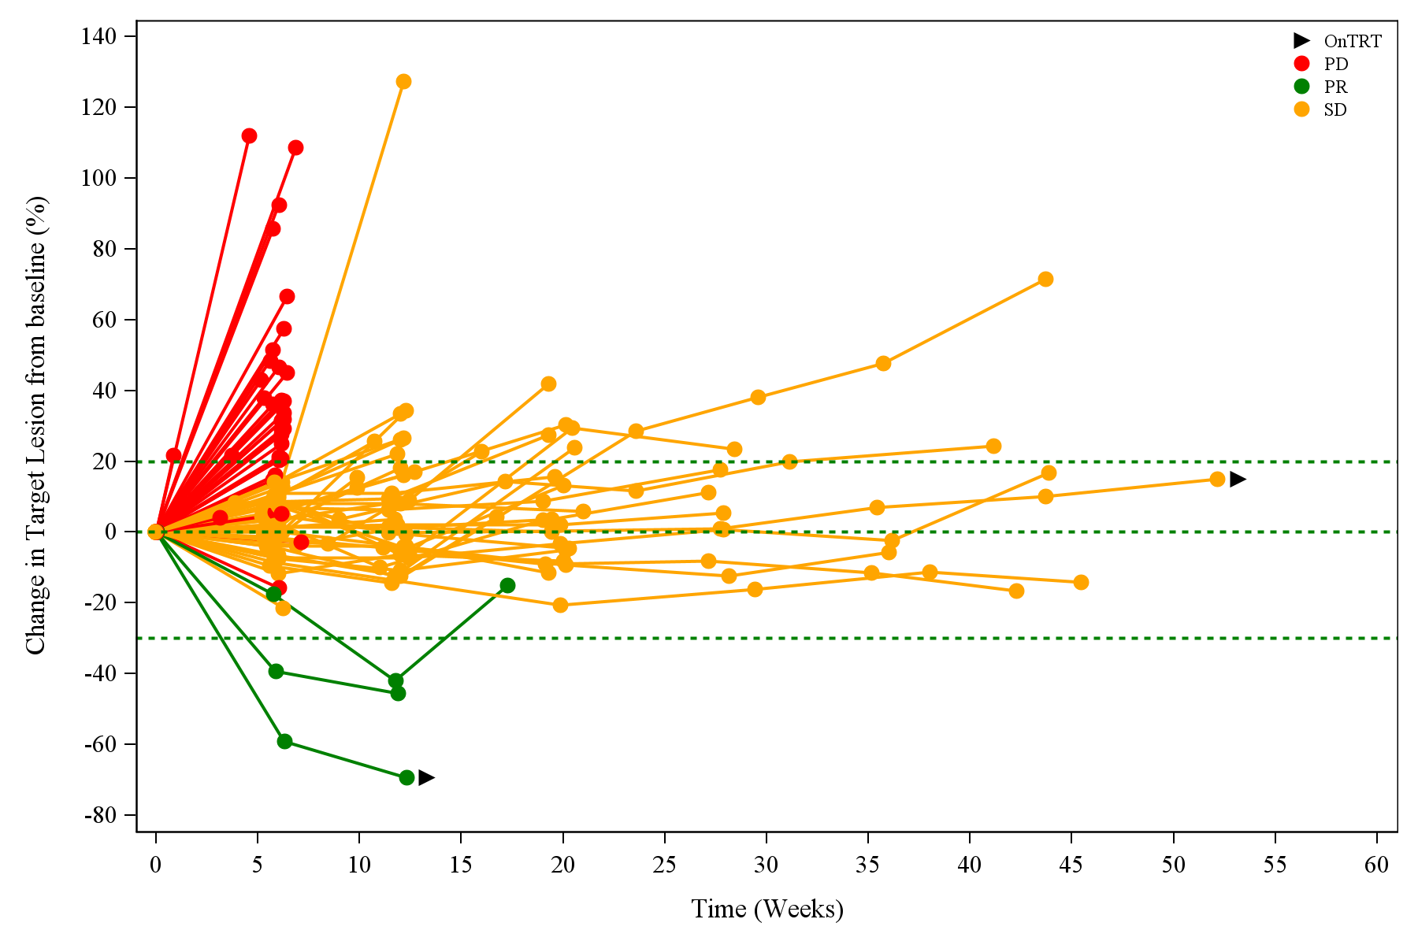
Ba3011 monotherapy antitumor activity
140
DCR* = 37/86 (43.0%)
(95% CI, 32.4–54.2)
120
100
80
60
40
Change in target lesion from baseline (%)
20
0
-20
-40
On treatment
-60
Progressive disease
Stable disease
-80
Partial response
0
5
10
15
20
25
30
35
40
45
50
55
60
Time (weeks)
Disease control observed regardless of AXL expression
Confirmed partial responses observed among osteosarcoma patients (n=2)
*DCR defined as objective response or stable disease for ≥12 weeks; 1 patient lost to follow-up was not efficacy-evaluable.
Data cutoff date: November 27, 2023.
Abbreviation: DCR, disease control rate.

Slide 10
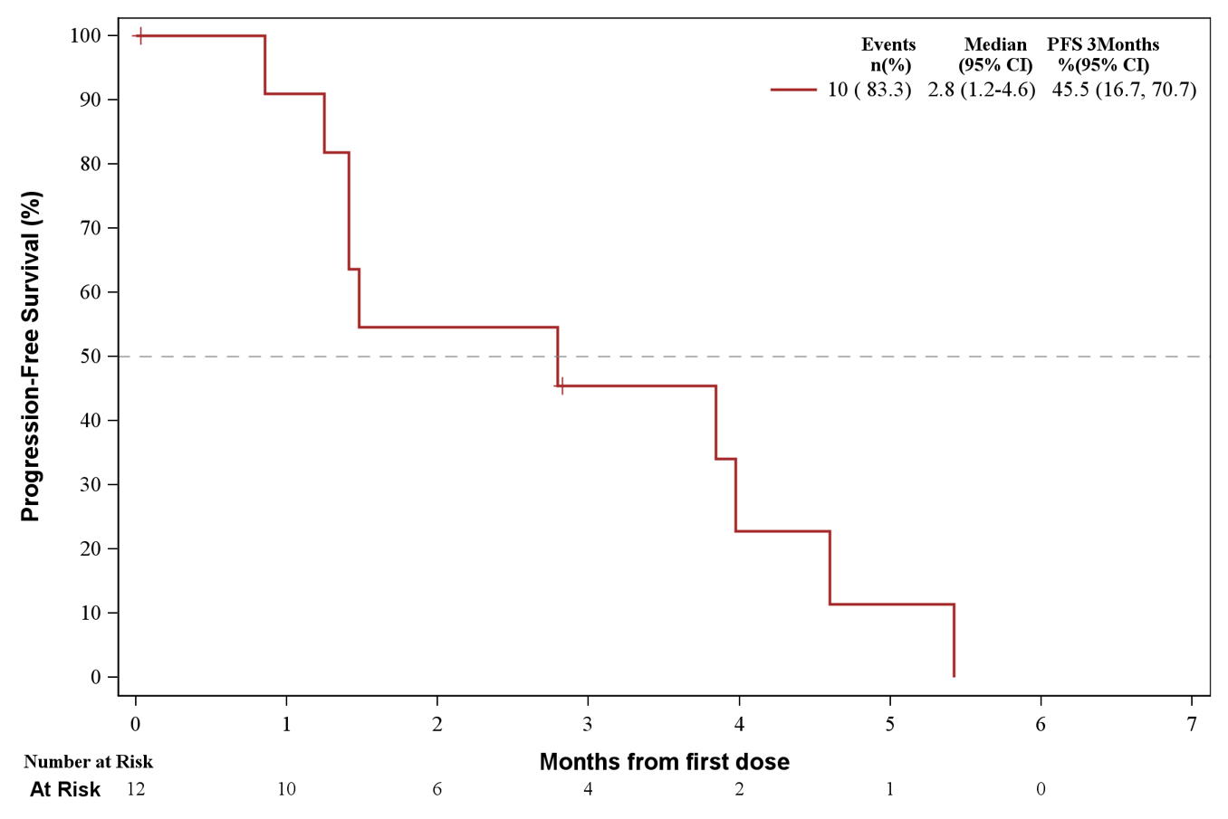
Osteosarcoma phase 2 pfs
BA3011 monotherapy
100
Events, n (%) | Median, months (95% CI) | PFS W12, % (95% CI)
11 (83.3) | 2.8 (1.2–4.6) | 45.5 (16.7–70.7)
90
80
70
60
50
PFS (%)
40
30
20
10
0
0
1
2
3
4
5
6
7
Months from first dose
Number at risk
12
10
6
4
2
1
0
Week 12 PFS of 45.5% exceeds COG threshold (40%) for establishing an “agent of interest” for additional development¹
2 out of 11 efficacy-evaluable patients with osteosarcoma achieved confirmed partial response
1. Lagmay JP, Krailo MD, Dang H, et al. J Clin Oncol. 2016;34(25):3031-3038.
Data cutoff date: November 27, 2023.
Abbreviations: COG, Children’s Oncology Group; PFS, progression-free survival; W, week.

Slide 11
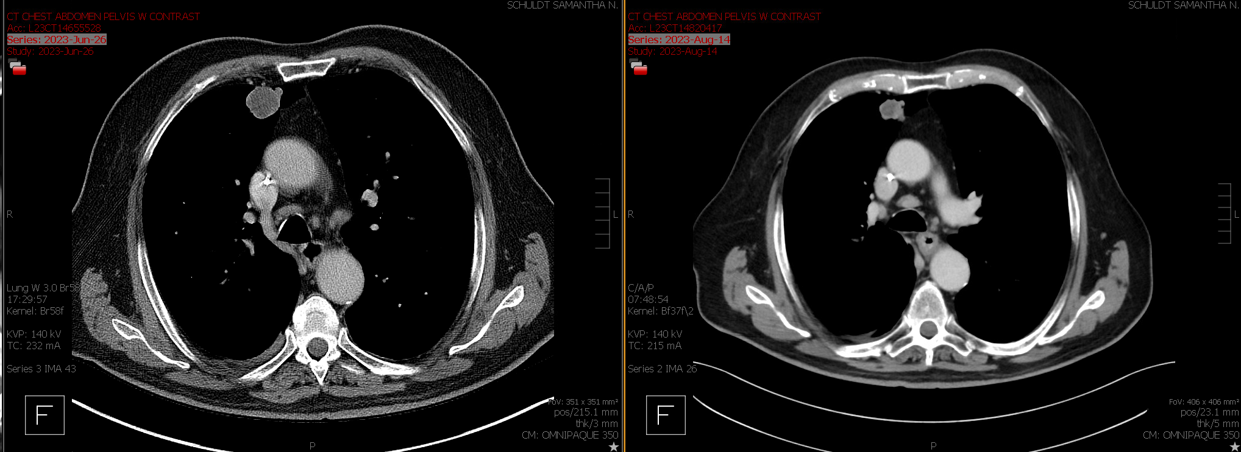
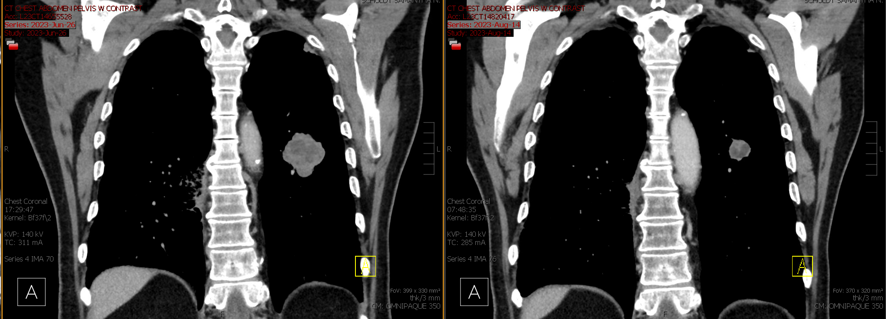
Osteosarcoma response to BA3011 monotherapy
83-year-old man previously treated with liposomal doxorubicin and cabozantinib
A
B
Baseline chest CT with contrast
(June 26, 2023)
C
D
Follow-up chest CT with contrast (August 14, 2023)
Data cutoff date: November 27, 2023.
Abbreviation: CT, computed tomography.

Slide 12
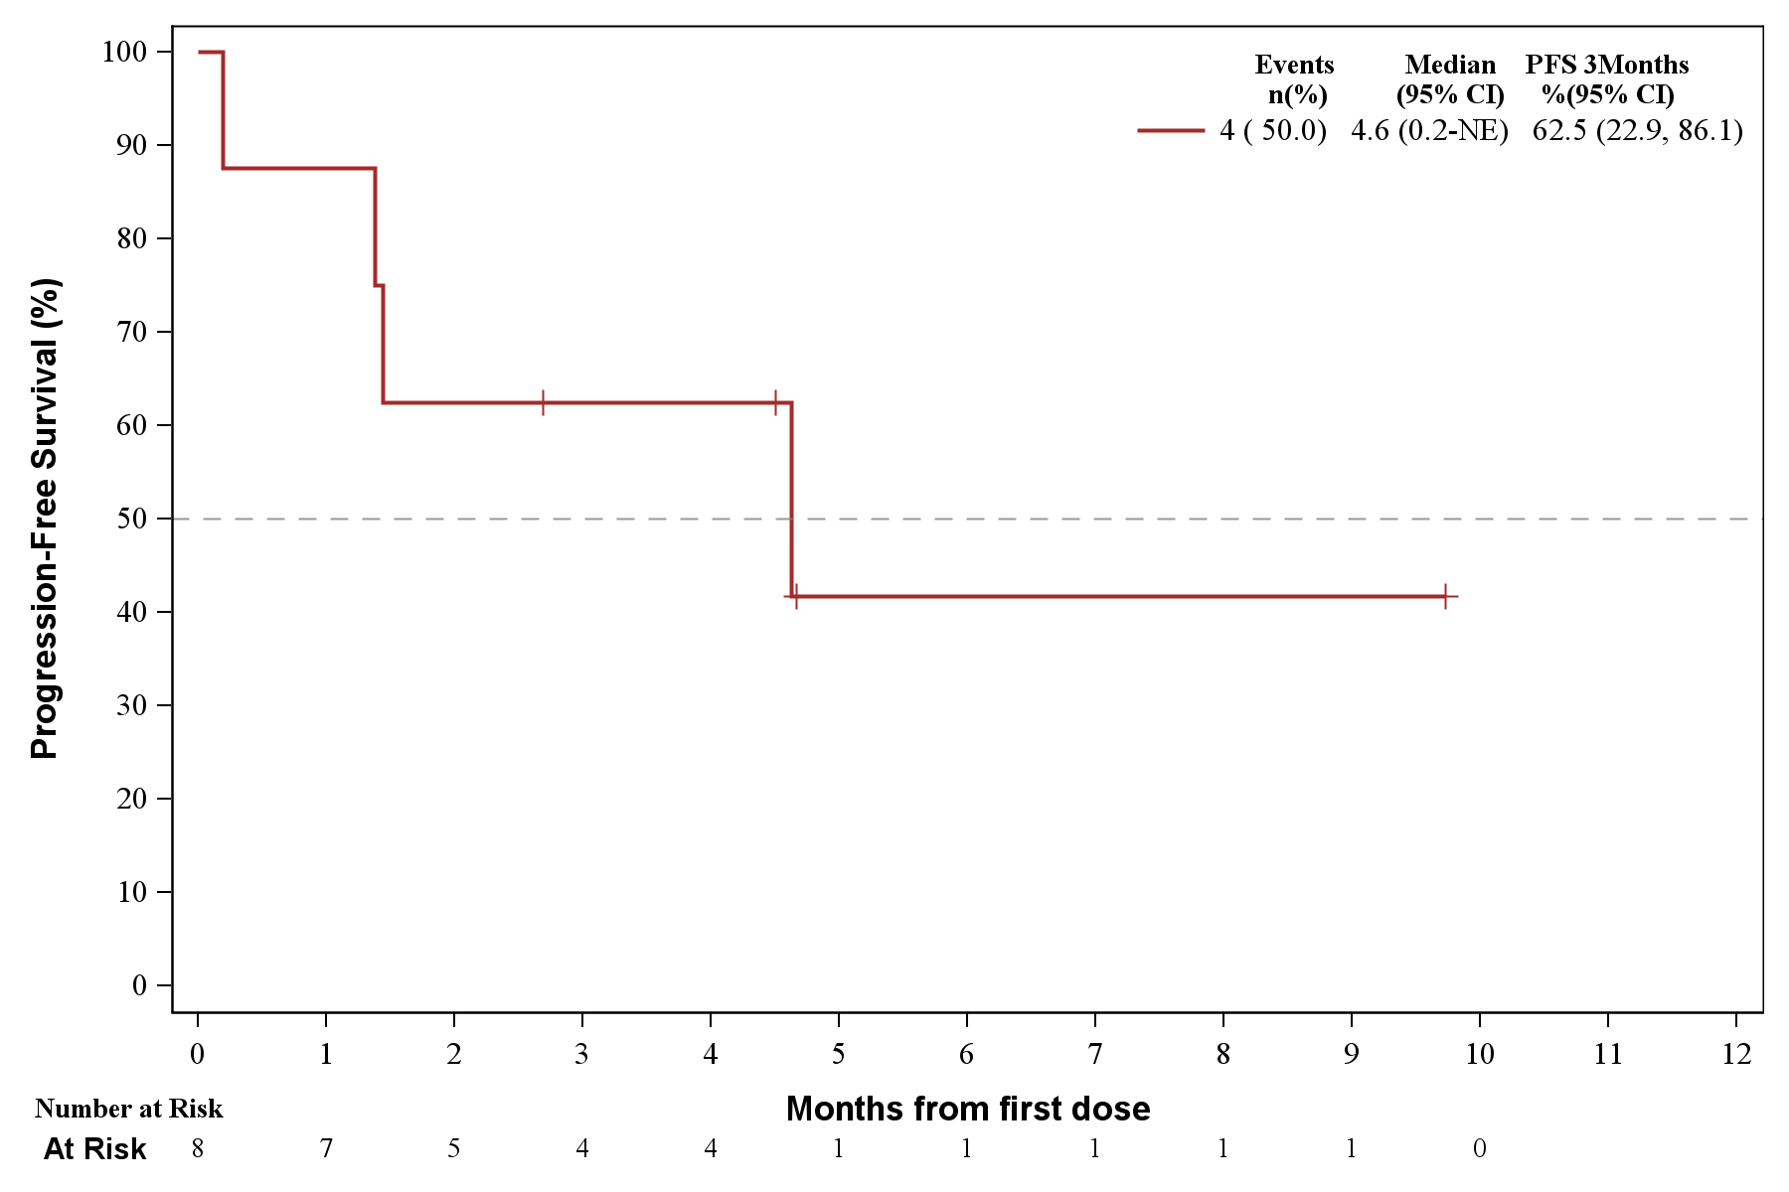
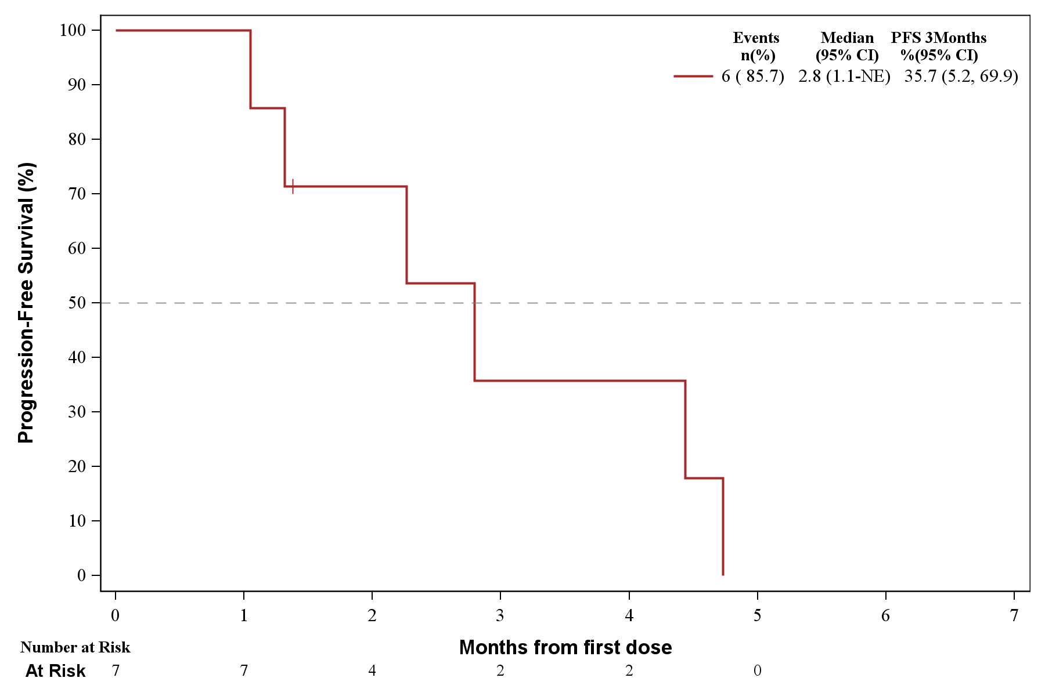
Liposarcoma and synovial sarcoma phase 2 pfs
BA3011 monotherapy
Liposarcoma
Synovial sarcoma
100
Events, n (%) | Median, months (95% CI) | PFS W12, % (95% CI)
4 (50.0) | 4.6 (0.2–NE) | 62.5 (22.9–86.1)
100
Events, n (%) | Median, months (95% CI) | PFS W12, % (95% CI)
6 (85.7) | 2.8 (1.1–NE) | 35.7 (5.2–69.9)
90
90
80
80
70
70
60
60
50
PFS (%)
PFS (%)
50
40
40
30
30
20
20
10
10
0
0
0
1
2
3
4
5
6
7
8
9
10
11
12
0
1
2
3
4
5
6
7
Months from first dose
Months from first dose
Months from first dose
Number at risk
Number at Risk
BA3011
8
7
5
4
4
1
1
1
1
1
0
Number at risk
7
7
4
2
2
0
Data cutoff date: November 27, 2023.
Abbreviations: NE, not evaluable; PFS, progression-free survival; W, week.

Slide 13
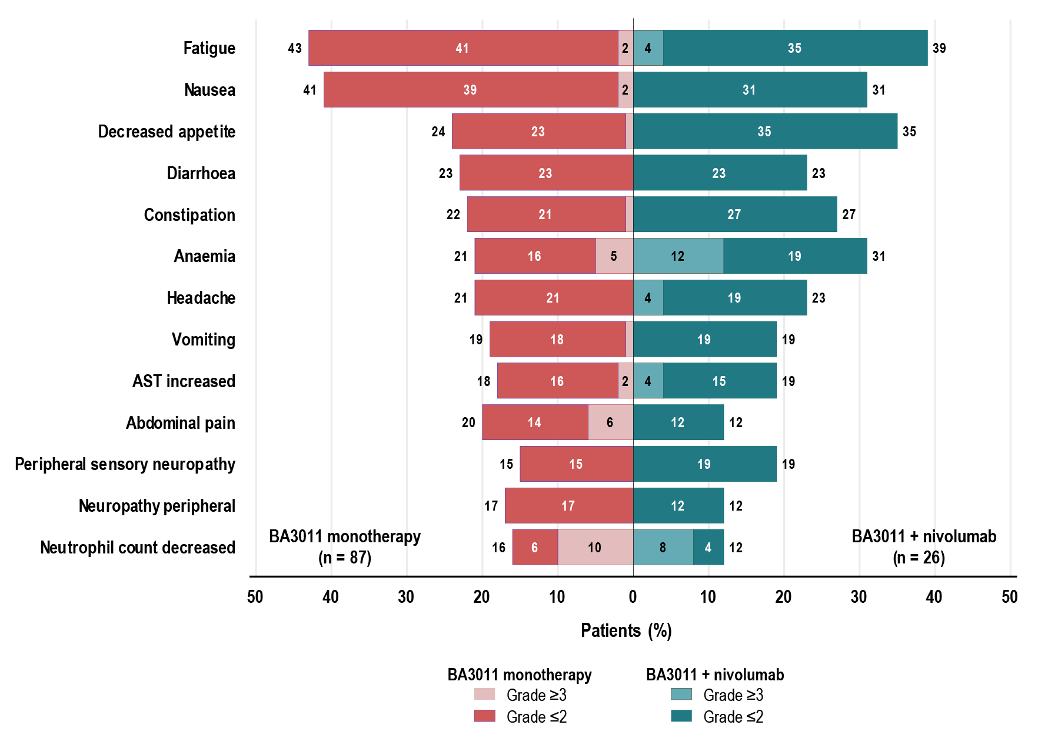
Safety summary
Broadly well tolerated; most events low-grade and reversible
Most frequent TEAEs (≥15% of patients)
Summary of TEAEs
Characteristic, n (%) | BA3011 monotherapy (n=87) | BA3011 + nivolumab (n=26)
Any TEAE | 85 (97.7) | 24 (92.3)
Related TEAEs with CTCAE grade 3 or 4* | 26 (29.9) | 11 (42.3)
Related serious TEAEs* | 4 (4.6) | 6 (23.1)
Related TEAEs leading to death* | 0 | 0
Related TEAEs leading to treatment discontinuation* | 7 (8.0) | 1 (3.8)
*As assessed by the investigator. Missing responses were counted as related.
Related TEAEs of Special Interest
Characteristic, n (%) | BA3011 monotherapy (n=87) |  | BA3011 + nivolumab (n=26)
 | All grades | Grades 3–4 | All grades | Grades 3–4
Peripheral neuropathy | 27 (31.0) | 0 | 7 (26.9) | 0
Neutropenia | 18 (20.7) | 14 (16.1) | 5 (19.2) | 4 (15.4)
Abnormal liver function tests | 14 (16.1) | 3 (3.4) | 3 (11.5) | 1 (3.8)
Hyperglycemia | 3 (3.4) | 1 (1.1) | 1 (3.8) | 0
Data cutoff date: November 27, 2023.
Abbreviations: AST, aspartate aminotransferase; CTCAE, Common Terminology Criteria for Adverse Events; TEAE, treatment-emergent adverse event.

Slide 14
Conclusions
Every-other-week delivery of an AXL-targeted ADC, mecbotamab vedotin, attained disease control in 43% of patients with treatment-refractory sarcomas
Treatment responses were observed among patients with osteosarcoma (2 PRs; week 12 PFS rate = 45.5%) and undifferentiated pleomorphic sarcoma (UPS; reported previously)¹
Toxicity was manageable and few high-grade related TEAEs were observed
  Very few related TEAEs led to treatment discontinuation
Data observed thus far justifies further evaluation of mecbotamab vedotin, particularly among patients with osteosarcoma and UPS; a Phase 2 registrational study is ongoing (NCT03425279)
1. Wilky B, Druta M, Ahnert JR, et al. Poster presented at: Connective Tissue Oncology Society Annual Meeting; November 10-13, 2021.
Abbreviations: ADC, antibody-drug conjugate; PFS, progression-free survival; PR, partial response; TEAE, treatment-emergent adverse event.

Slide 15
THANK YOU

Slide 16
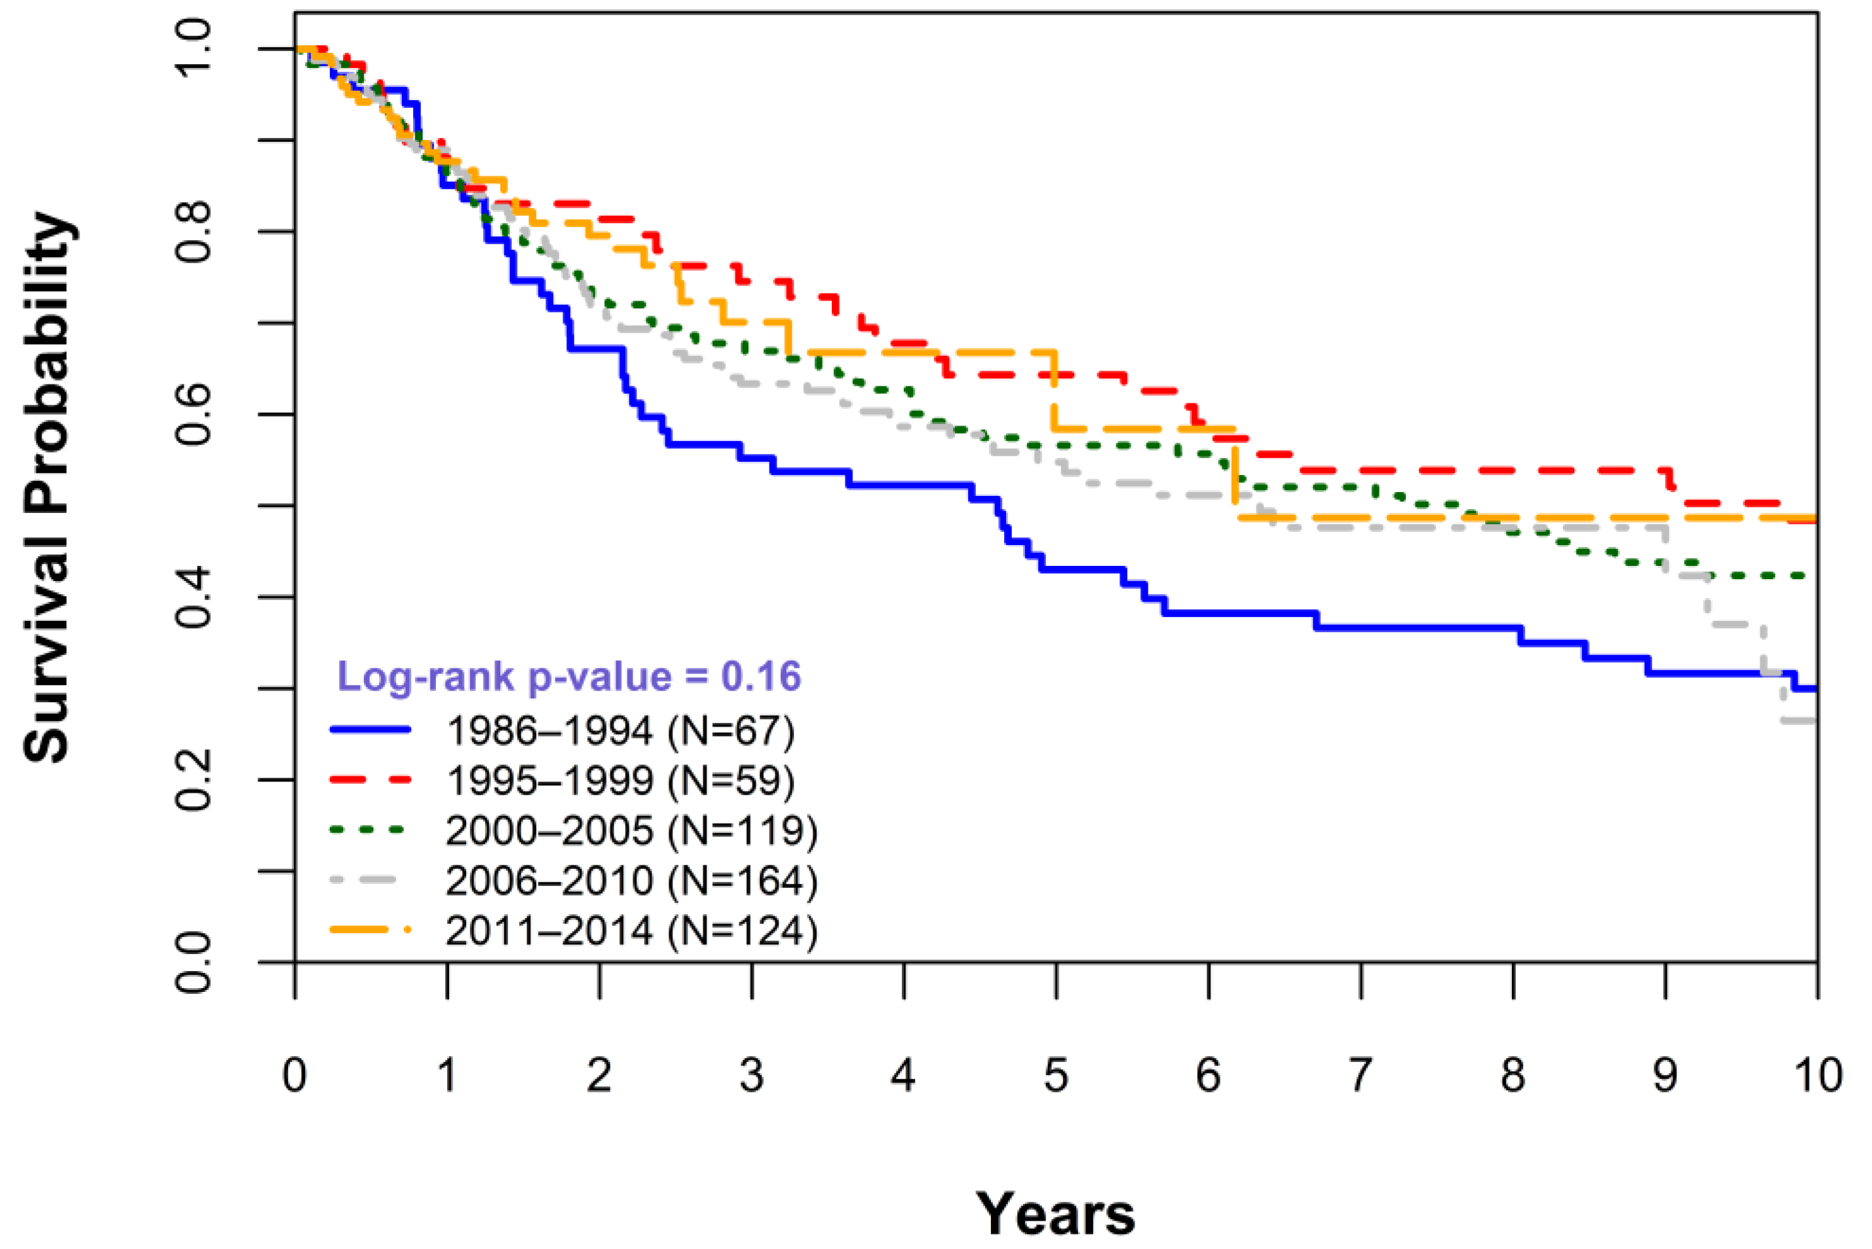
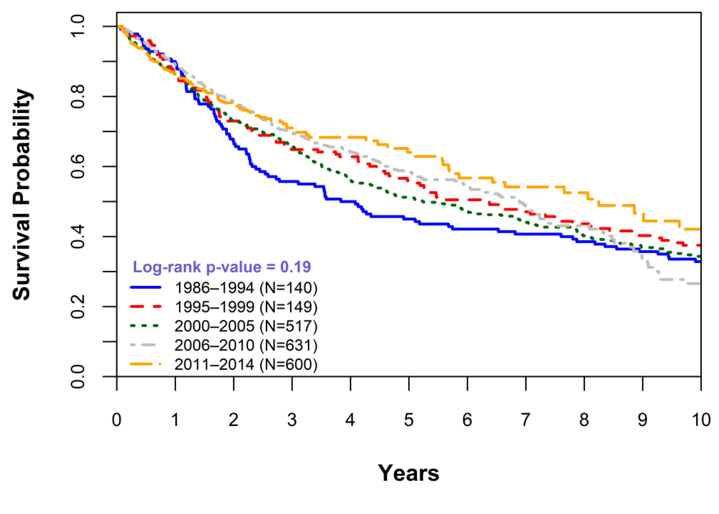
SARCOMAs REMAIN difficult to treat
Limited improvements in overall survival over time for bone and soft tissue sarcomas¹
Kaplan–Meier survival curves by year of diagnosis for patients with bone sarcomas at a tertiary cancer center
Kaplan–Meier survival curves by year of diagnosis for patients with soft tissue sarcomas at a tertiary cancer center
1. Stricker E, Reed DR, Schabath MB, Sok P, Scheurer ME, Lupo PJ. Cancers (Basel). 2023; 15(2):514.

